Slide 1


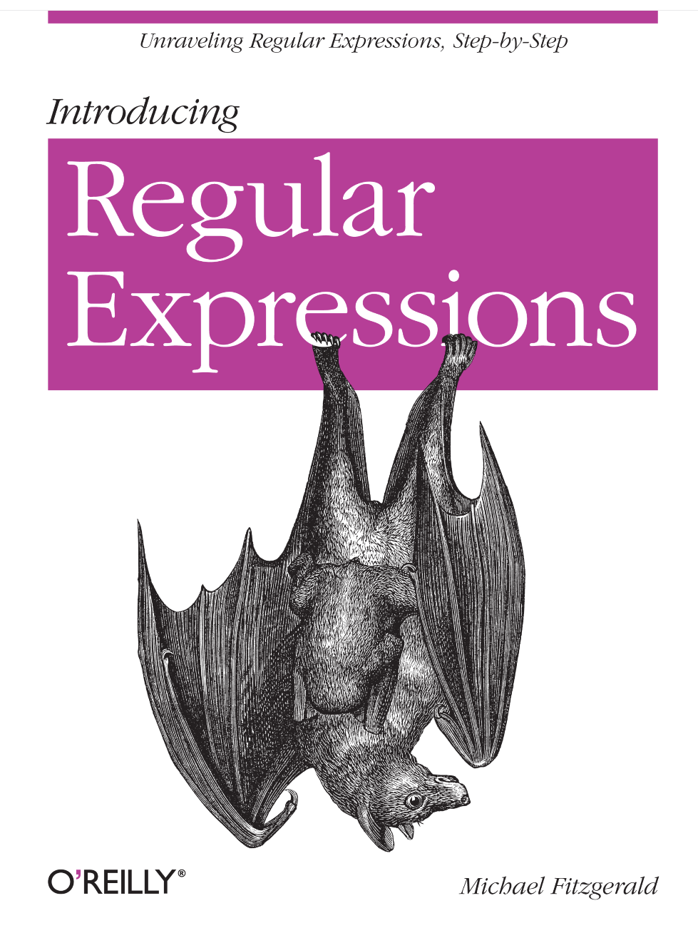
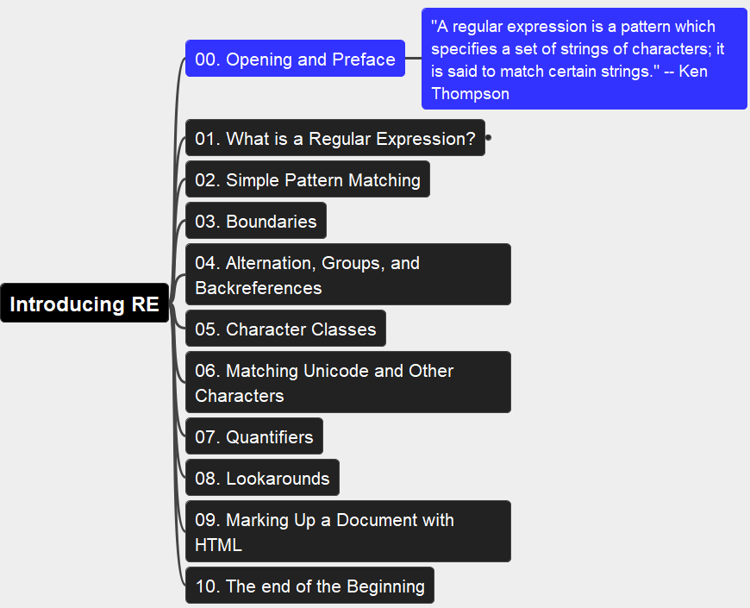
Introducing Regular Expressions
001
Opening and Preface
Thanks for Author: Michael Fitzgerald

Slide 2
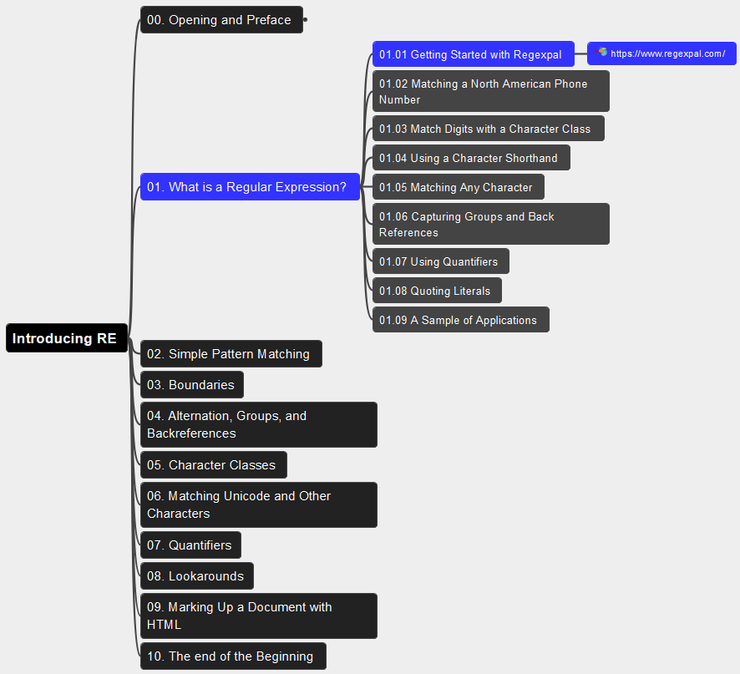
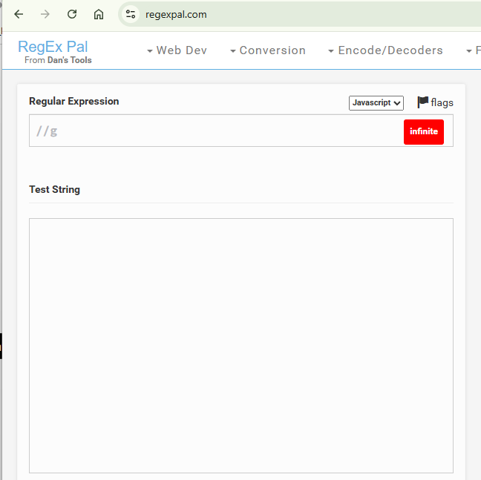
01. What is a Regular Expression? 01.01 Getting Started with Regexpal
002

Slide 3
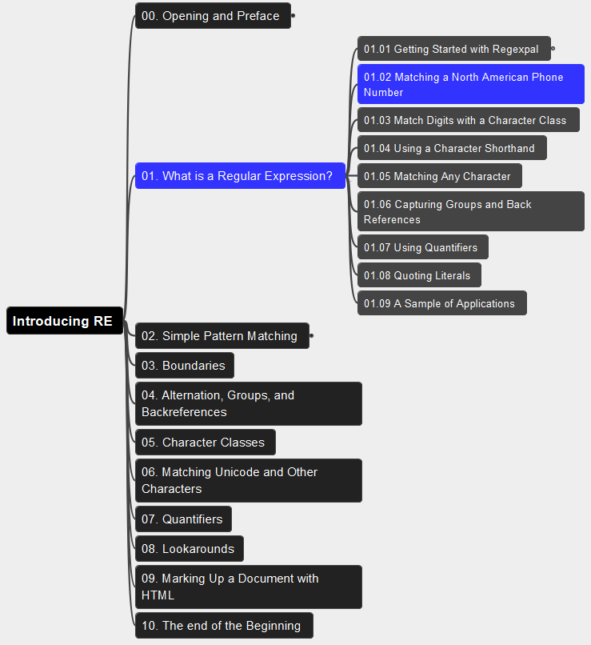
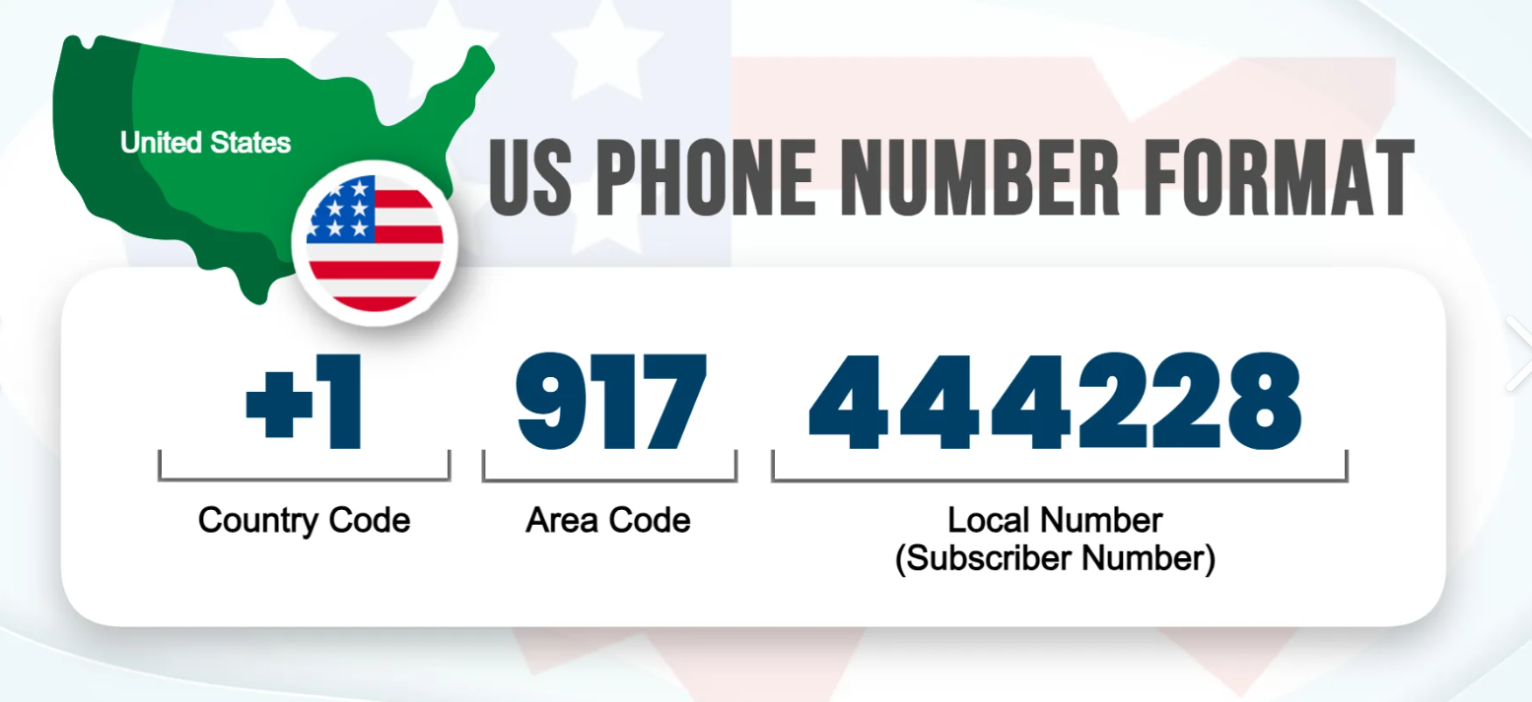
01. What is a Regular Expression? 01.02 Matching a North American Phone Number
003

Slide 4
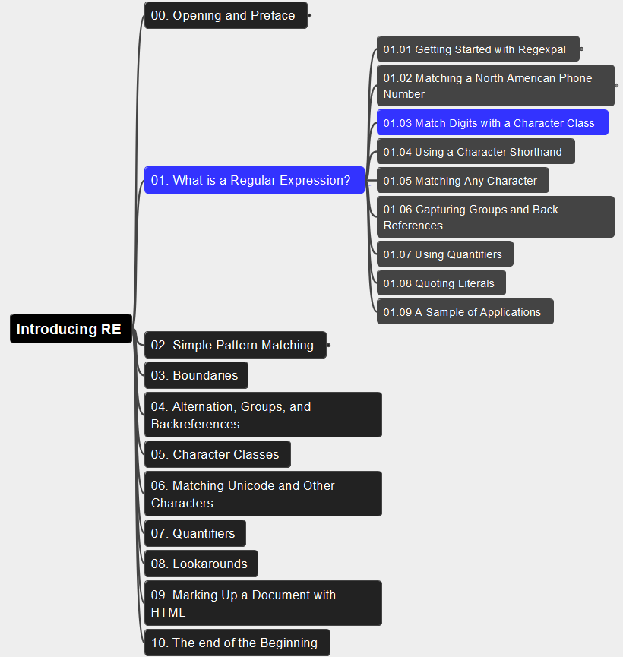
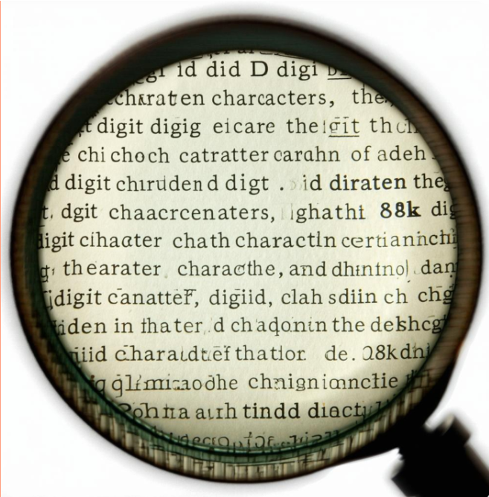
01. What is a Regular Expression? 01.03 Match Digits with a Character Class
004

Slide 5
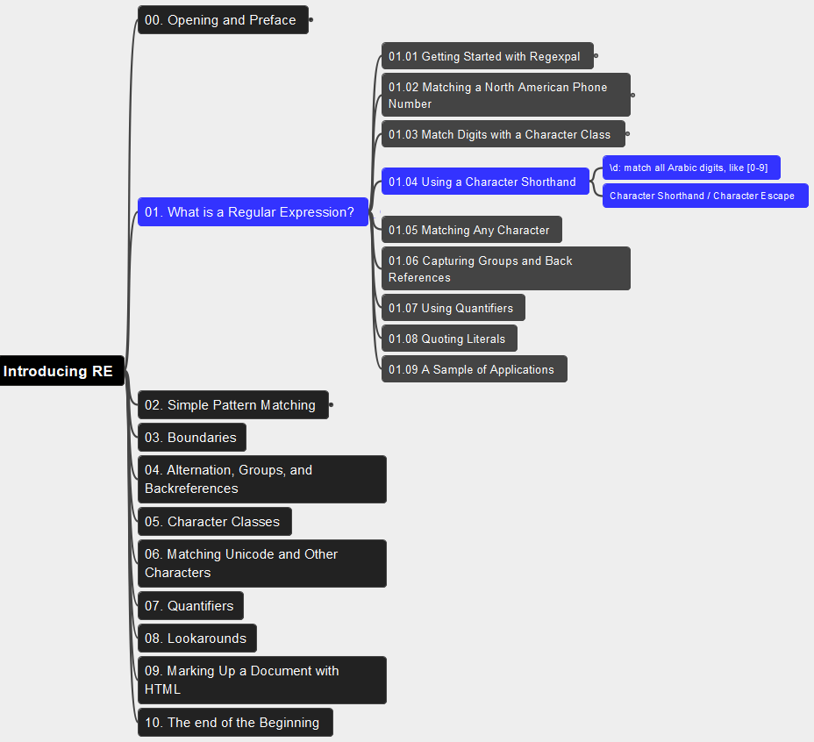
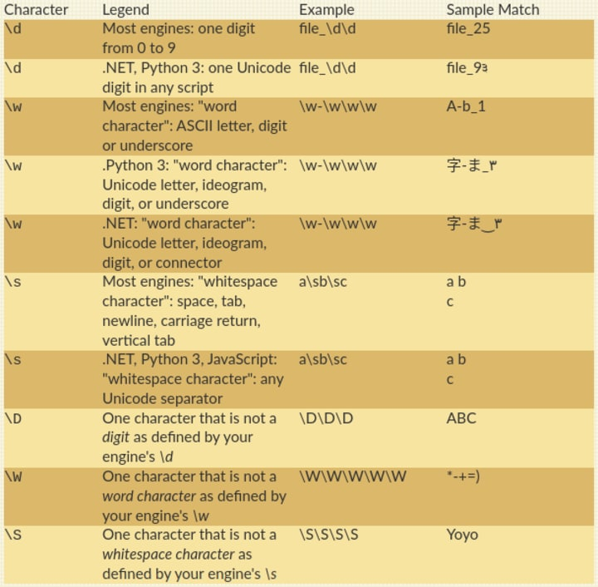
01. What is a Regular Expression? 01.04 Using a Character Shorthand
005

Slide 6
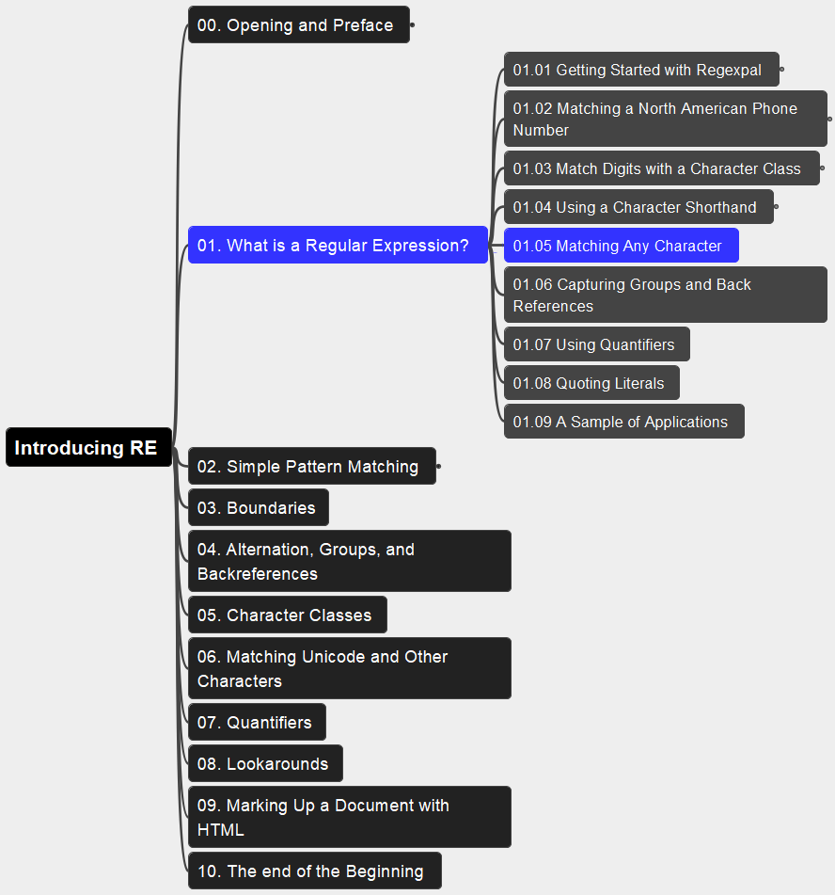
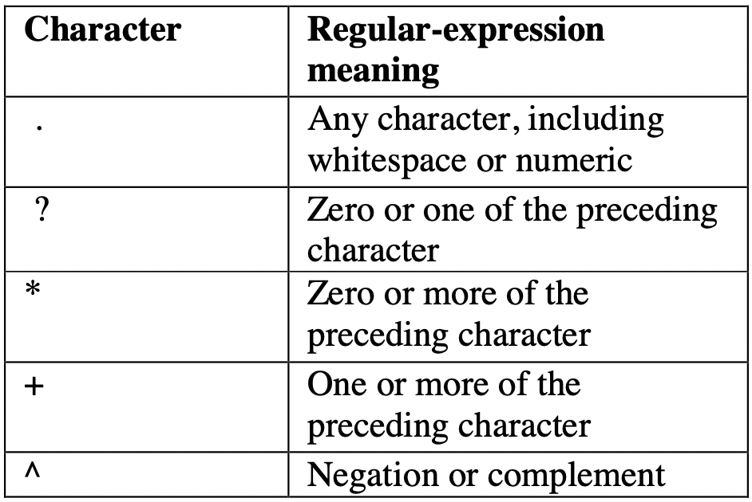
01. What is a Regular Expression? 01.05 Matching Any Character
006

Slide 7
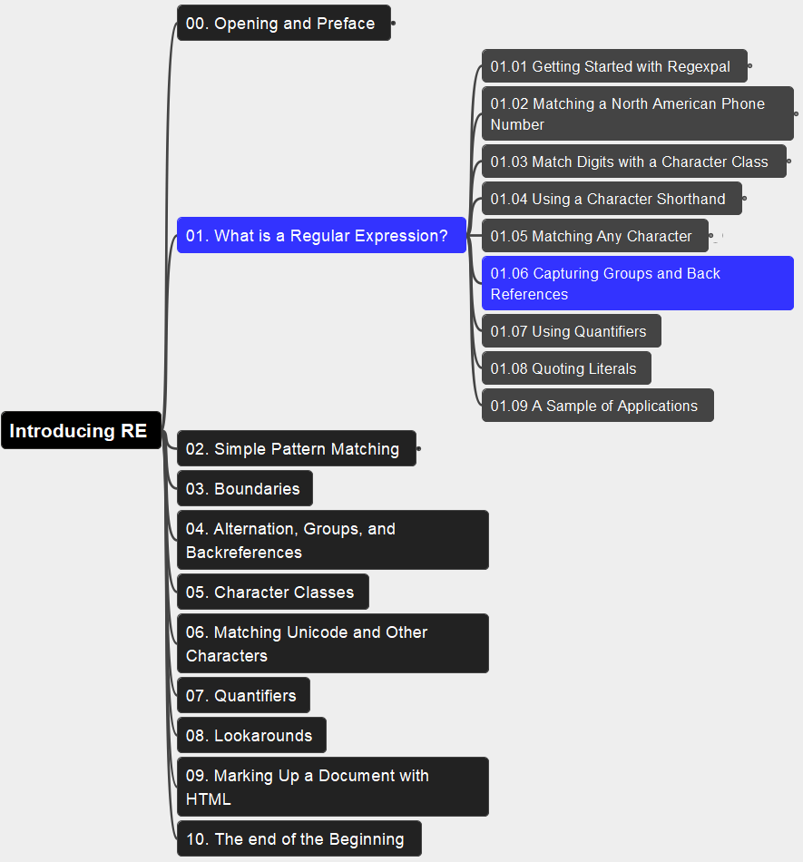
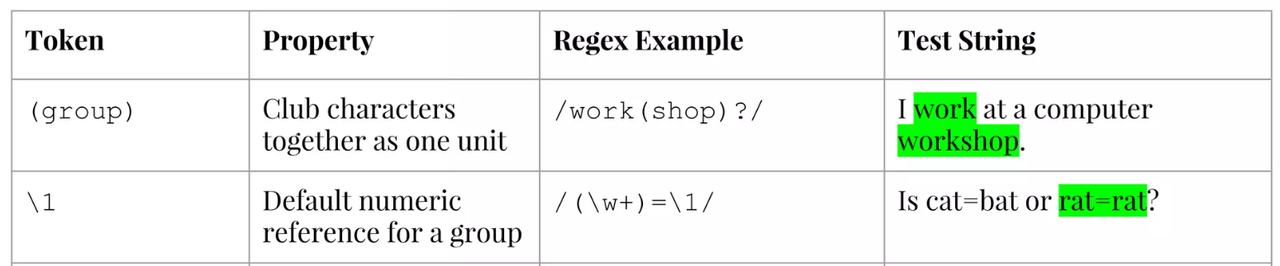
01. What is a Regular Expression? 01.06 Capturing Groups and Back References
007

Slide 8
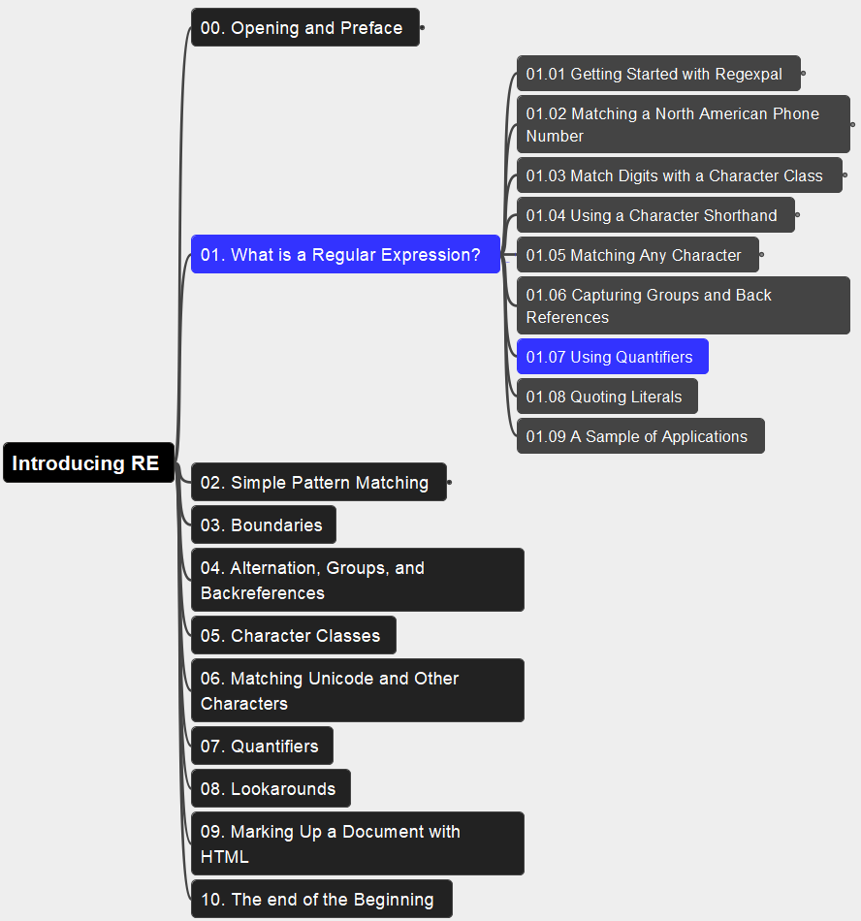
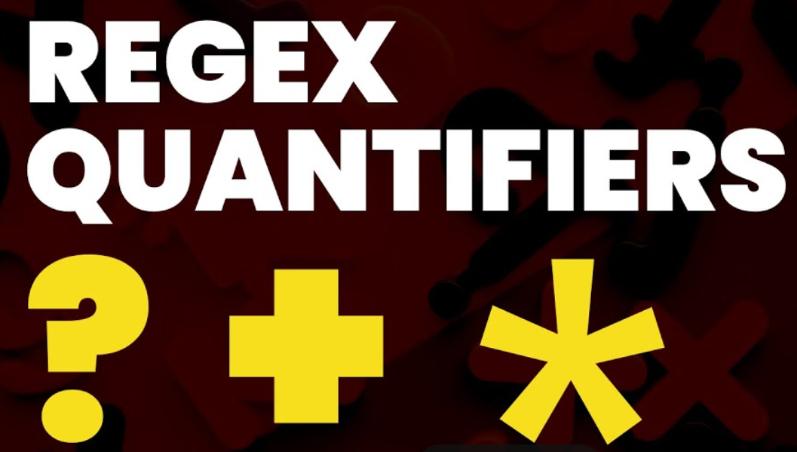
01. What is a Regular Expression? 01.07 Using Quantifiers
008

Slide 9
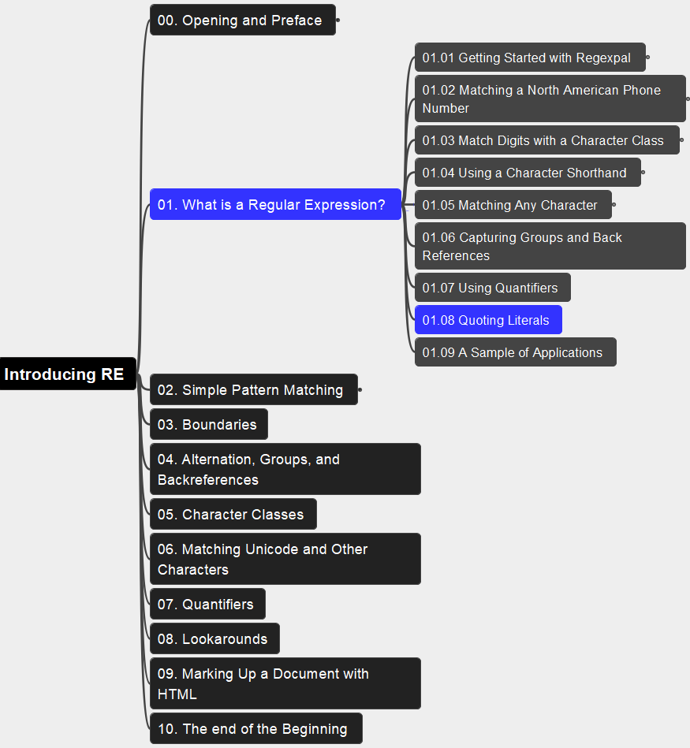
01. What is a Regular Expression? 01.08 Quoting Literals
009

Slide 10
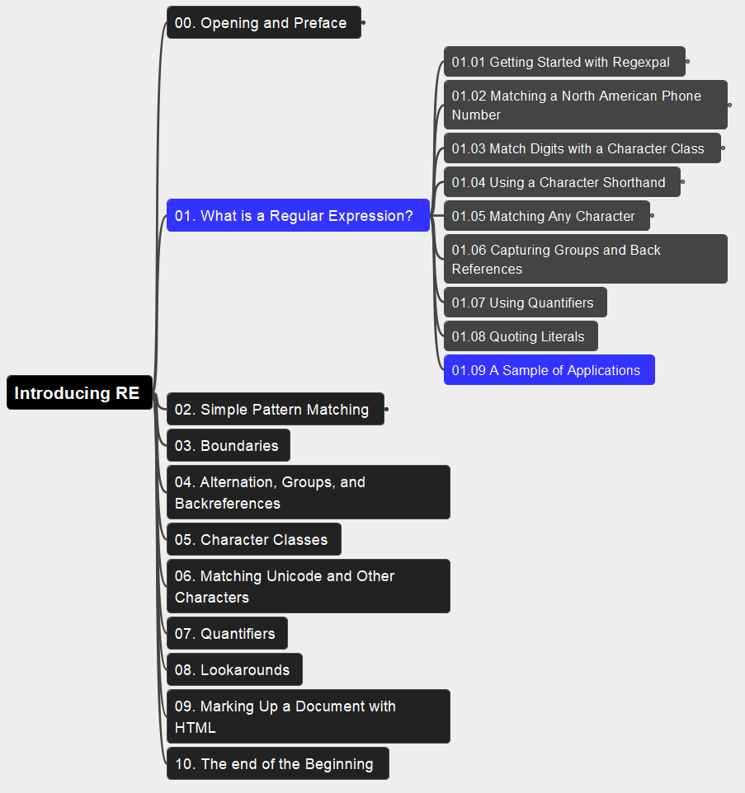
01. What is a Regular Expression? 01.09 A Sample of Applications
010

Slide 11
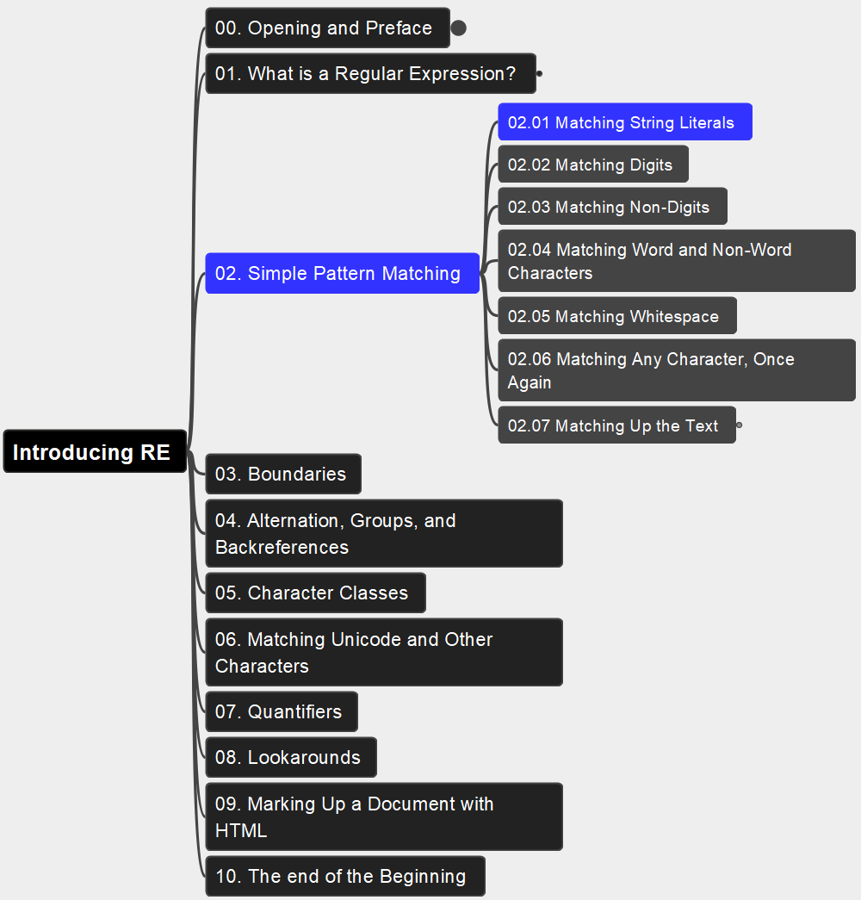
02. Simple Pattern Matching 02.01 Matching String Literals
011

Slide 12
02. Simple Pattern Matching 02.02 Matching Digits
012

Slide 13
02. Simple Pattern Matching 02.01 Matching String Literals
013

Slide 14
02. Simple Pattern Matching 02.01 Matching String Literals
014

Slide 15
02. Simple Pattern Matching 02.01 Matching String Literals
015

Slide 16
02. Simple Pattern Matching 02.01 Matching String Literals
016

Slide 17
02. Simple Pattern Matching 02.01 Matching String Literals
017

Slide 18
02. Simple Pattern Matching 02.01 Matching String Literals
018

Slide 19

Thank You!
xiaoqizhao@outlook.com

